Slide 1
Practical aspects of
Spike Sorting
(supplementary materials)
Mike Sintsov
Head of Man-Machine Interfaces
at Motorica LLC

Slide 2
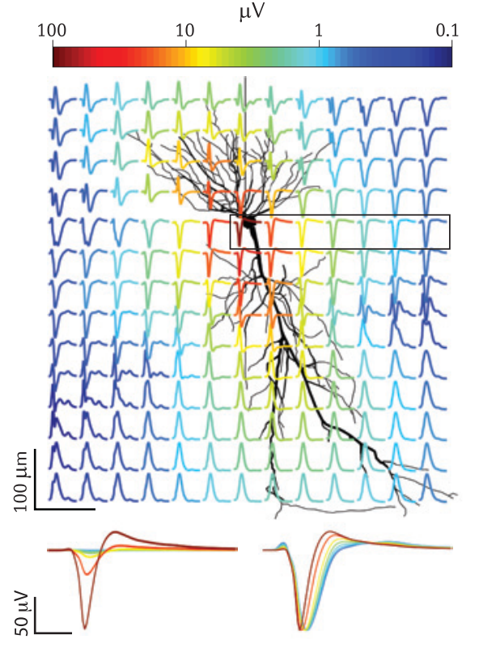
What is spike sorting
Spike sorting is data clustering and segmentation problem using recordings of extracellular action potentials in order to find robust markers of exact cell activity
10.1038/nrn3241

Slide 3
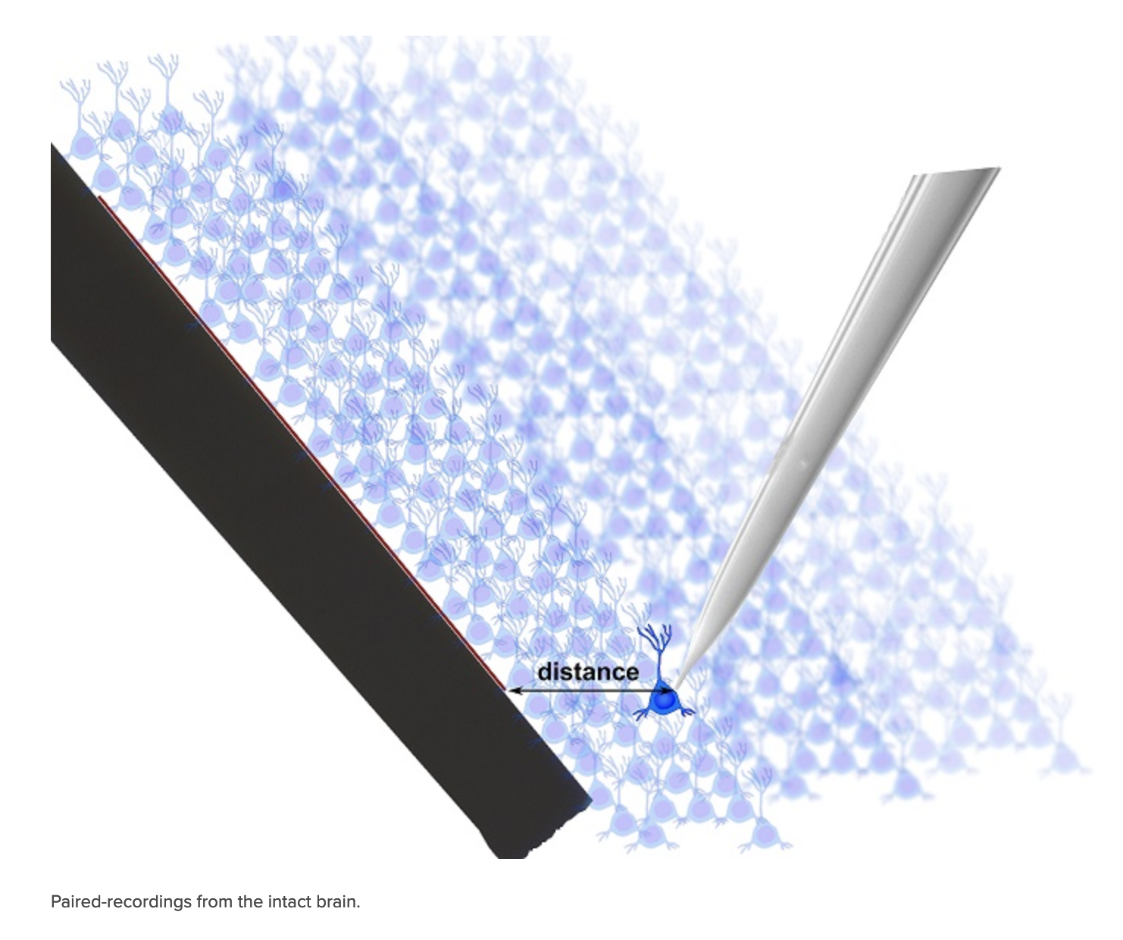

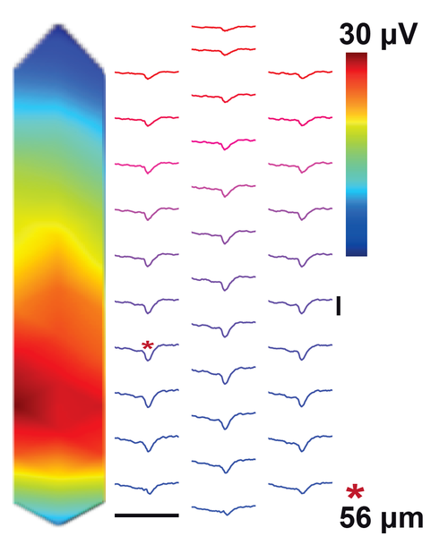
Dataset
http://www.kampff-lab.org/validating-electrodes

Slide 4
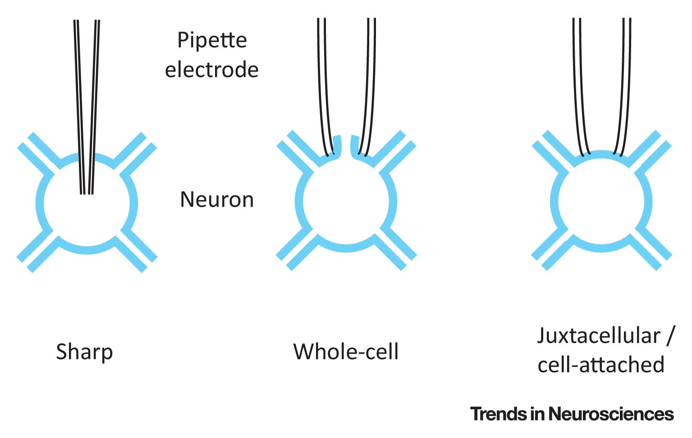
What is juxtacellular recordings?

Slide 5
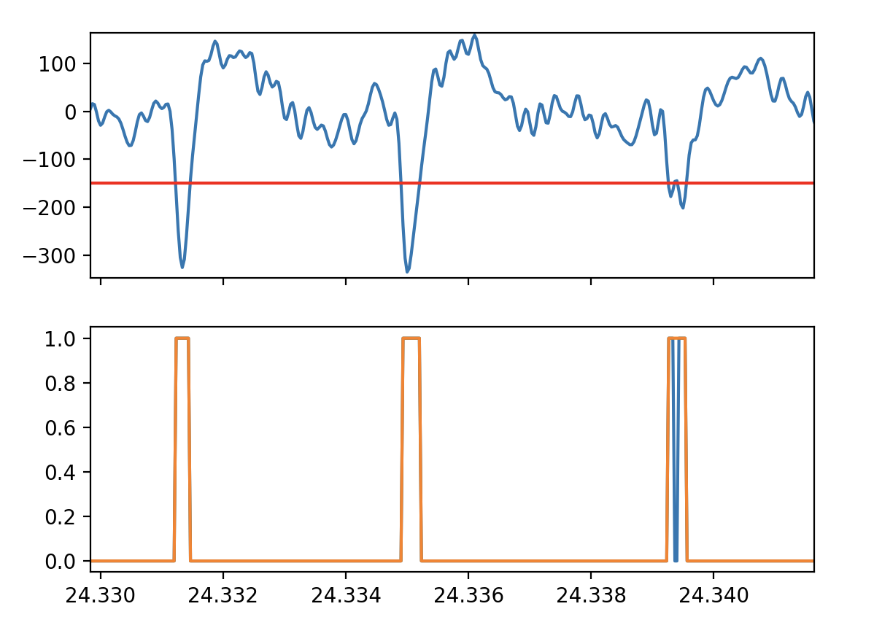

Binary closing

Slide 6
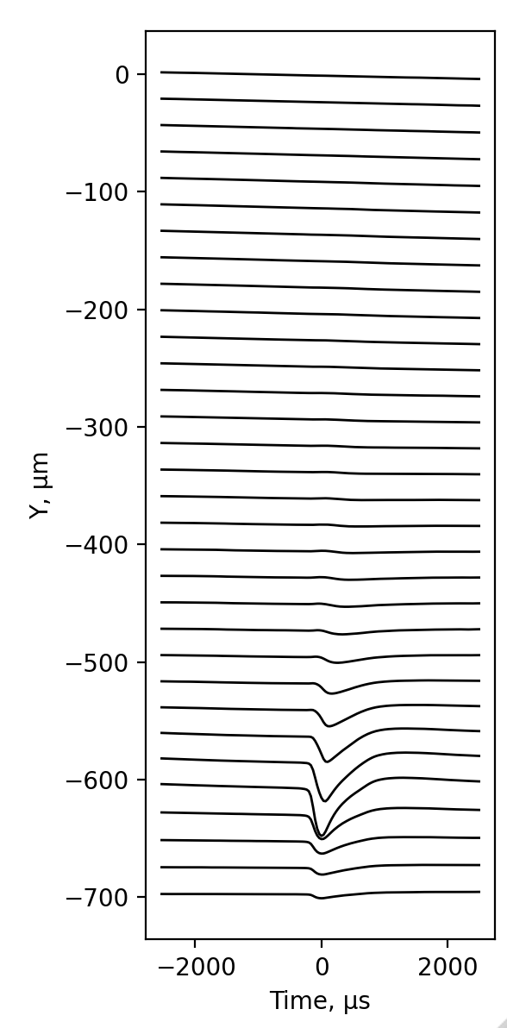
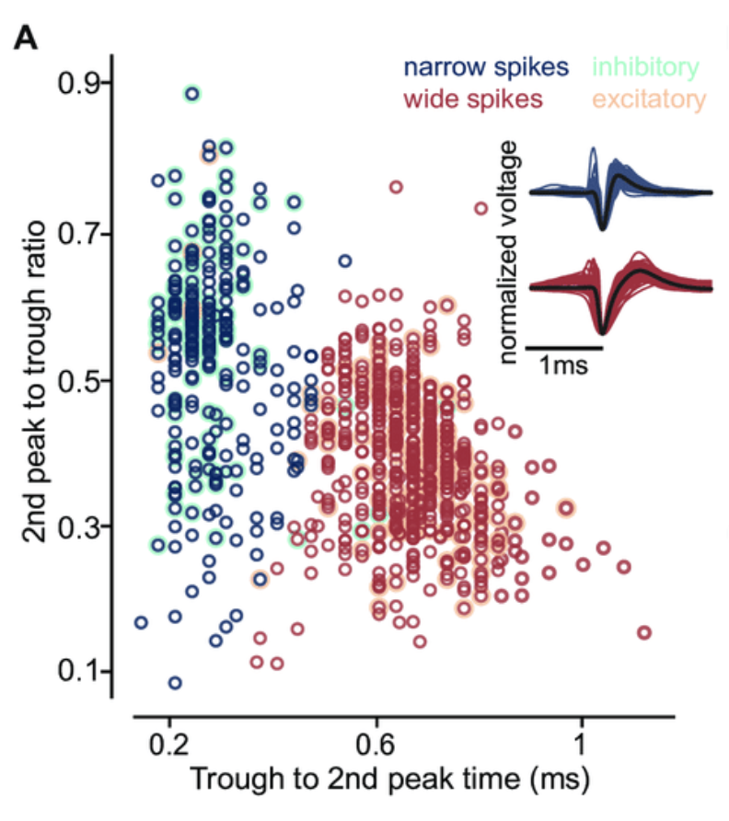
Putative excitatory and inhibitory neurons
10.1101/2021.01.22.427789.

Slide 7
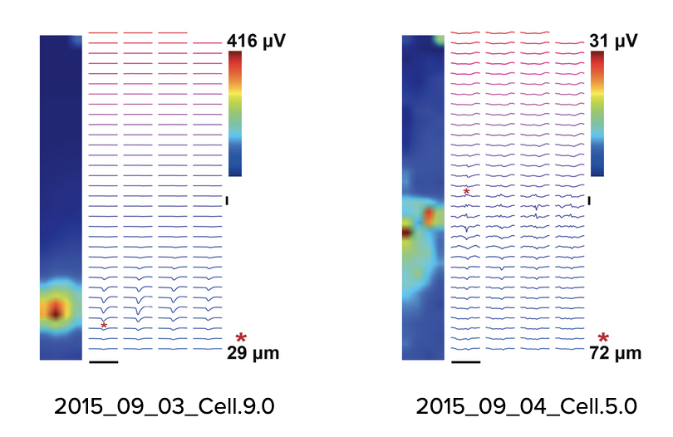
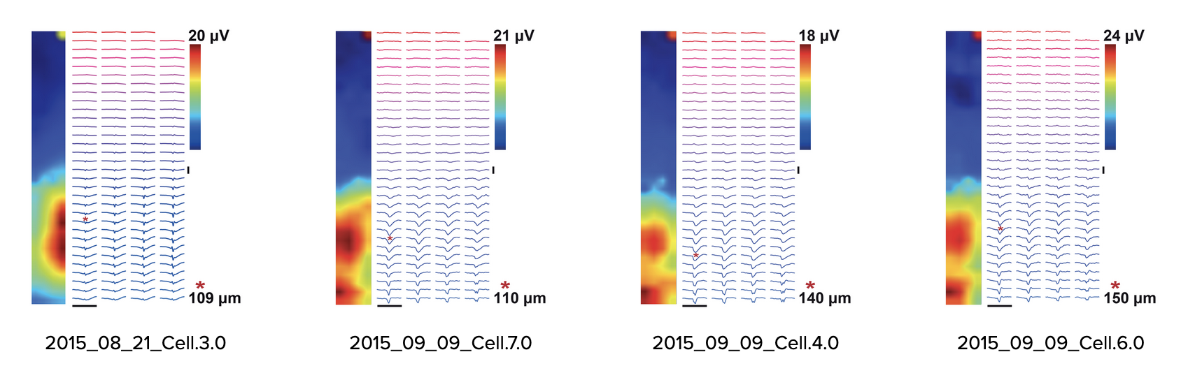
Homework
Take the script and any of Neuroseeker probes and try to solve forward problem, try to construct these maps (these have better amplitudes)

Slide 8
Popular spike sorters
Klusta (phy) — Python, obsolete, but robust
Spyking circus — Python, uses GPU
Kilosort v3 — Matlab, uses GPU, developed for NeuroPixel data (400 channels)
YASS — Python, uses GPU and Artificial Neural Networks
See also: SpikeInterface Python (https://elifesciences.org/articles/61834)

